Slide 1
Medcalie
Oracle, Ethereum blockchain & Interoperability

Slide 2
Table of Contents
1
3
5
Introduction
Literature
Review
Proof of Concept
2
4
6
Problem & Solution
Analysis & Design
Conclusion

Slide 3
Introduction
Blockchain Technology
Interoperability
Oracles

Slide 4

Blockchain
Blockchain is a decentralized and transparent digital ledger technology that enables secure and immutable recording of transactions across multiple computers or nodes. It functions through a chain of blocks, each containing a unique cryptographic hash, which ensures the integrity and immutability of the data. By eliminating the need for intermediaries and providing a distributed consensus mechanism, blockchain offers potential applications in various fields, including finance, supply chain management, healthcare, and beyond.

Slide 5
Blockchain Transactions
On-Chain Transactions
Transactions & data storage within
a blockchain
Off-chain Transactions
Transactions & data storage outside a blockchain

Slide 6
Interoperability
Homogenous Interoperability
Refers to the seamless communication and interaction within a single blockchain network or among similar blockchain networks, ensuring compatibility and connectivity at the protocol level. It enables the exchange of assets and data within a standardized ecosystem.
Heterogenous Interoperability
Involves the integration and interaction between different blockchain networks or systems, whether they are of the same type or have different architectures, protocols, or standards. It facilitates the exchange of assets and data across diverse blockchain ecosystems, utilizing various interoperability solutions and external protocols.

Slide 7
Objectives
Digitization
Complying with HL7
Comprehensive digitized system
Optimal HL7 version to the system
Monitoring
Blockchain Utilization
Strict transaction monitoring
Enhanced ecosystem utilizing blockchains
Authorization
Standardization
Restricting behavioral authorities of personnel
Standardizing code sets

Slide 8
Functional Requirements
Patient & Doctor must be able to fetch patient’s health record
Insurance must be able to accept or reject claims based on patient’s allowance coverage
Fetch PHR
Respond to claims
Enter prescription
Doctor must be able to enter prescriptions
Request lab work
Redirect to another doctor
Doctor should be able to request lab works & scans
Doctor should be able to redirect patient to another doctor

Slide 9
Non-Functional Requirements
Insurance could update network
Doctor and patient to view tokens
Update network
View tokens
Update PHR
Doctor could update patient’s health record
Encryption
Privacy
Level of protection required for different types of data
Secure and protect data from unauthorized access or tampering

Slide 10
Expected Contributions
High Scalability
Standardization
Single point of failure tolerance
HL7 compliancy
Interoperability
Anonymity
Utilized oracle use facilitating blockchains communications
Absolute confidentiality of patient’s record

Slide 11

Interoperability
Collaborating Blockchains
Consensus & Governance
03
04
Promotes seamless collaboration between blockchains
Maintains respective consensus mechanisms and governance models while still interacting with each other
Scalability & Performance
02
05
Network Resilience & Security
Offloads transactions to compatible chains
Reduces the risk of a single point of failure
Cross-Chain Asset Transfer
01
06
Data Sharing & Standardization
Allows transfer of digital assets between different blockchains enhancing liquidity and flexibility
Shared resources leads to establishment of common data standards or protocols facilitating data integration

Slide 12

Oracles
A blockchain oracle is a trusted external data source that securely provides real-world information to a blockchain network. It serves as a bridge between the blockchain and the outside world by fetching and validating data, such as prices, weather conditions, or events, and making it accessible within the blockchain. Oracles play a crucial role in enabling smart contracts and decentralized applications (DApps) to interact with real-world data, enhancing the functionality and versatility of blockchain systems.

Slide 13
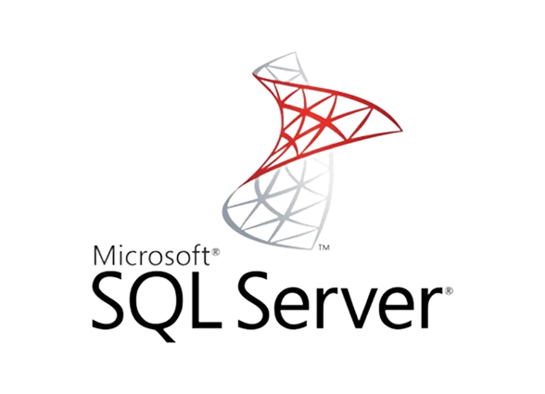

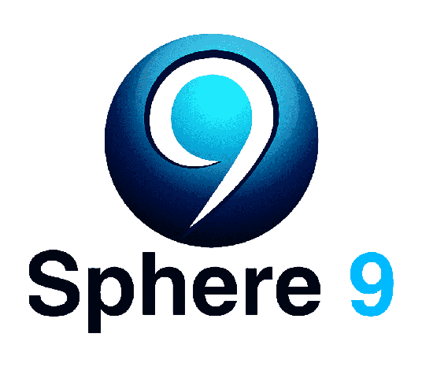

Oracle
Alternatives
MS SQL Server
Talend
IMDB Speher 9
Apache nifi
In-memory processing capability
Open-source platform
Seamless integration with IMDB products
Flexible framework for data routing

Slide 14
Why Oracles?
System Data Supplier
Secure
Aggregates and integrates data providing a unified access point
Robust security measures to protect against data tampering or manipulation
Source of Truth
Accurate & Reliable
Obtains data from various trusted sources
Mechanisms to validate and verify the data they receive

Slide 15
Oracles Integration
Blockchains Interoperability
Progressive communication between ecosystem’s blockchains
Off-Chain Gathering
Communication between system and external healthcare providers

Slide 16
Problem & Solution
Problem Statement
Motivation
Objectives
HL7 Compliance

Slide 17
Problem Statement
01
Fraudulent activities involving forgery
Insurance Leakage
occurs when the actual claim payouts exceed what should be legitimately covered by insurance policies

Slide 18
Occurrence
Phantom Therapy
In 2019, a prominent medical practitioner in the United States was arrested for running an extensive prescription fraud scheme. The healthcare provider forged prescriptions for opioids, painkillers, and other controlled substances, which were then submitted to insurance companies for reimbursement.
https://www.justice.gov/criminal-fraud/hcf-2020-takedown/case-descriptions

Slide 19
Problem Statement
01
Fraudulent activities involving forgery
02
Insurance Leakage
Privacy breaches on healthcare documents
occurs when the actual claim payouts exceed what should be legitimately covered by insurance policies

Slide 20
Occurrence
Anthem Inc. Data Breach
Anthem, one of the largest health insurance providers in the United States, experienced a massive data breach where hackers gained access to a database containing personal information of approximately 78.8 million individuals. The breached data included names, social security numbers, addresses, and medical identification numbers. This breach highlighted the vulnerability of centralized healthcare records and the potential for significant privacy breaches.
https://www.insurance.ca.gov/0400-news/0100-press-releases/anthemcyberattack.cfm

Slide 21

Problem Statement
01
Fraudulent activities involving forgery
02
Insurance Leakage
Privacy breaches on healthcare documents
03
Decentralization in terms of medical records
occurs when the actual claim payouts exceed what should be legitimately covered by insurance policies

Slide 22
Occurrence
The T-Systems Incident
In 2008, a power outage at a data center managed by T-Systems, the company responsible for the centralized electronic patient records system of the UK's National Health Service (NHS), resulted in a complete loss of access to patient records. This incident caused widespread disruptions in patient care, including delayed treatments and compromised patient safety. The incident highlighted the risks associated with relying on a single point of failure in centralized systems, emphasizing the need for robust backup and disaster recovery mechanisms to ensure the continuous availability of critical healthcare data.
https://www.latimes.com/business/la-xpm-2012-aug-03-la-fi-hospital-data-outage-20120803-story.html

Slide 23

Problem Statement
01
Fraudulent activities involving forgery
02
Insurance Leakage
Privacy breaches on healthcare documents
03
Decentralization in terms of medical records
occurs when the actual claim payouts exceed what should be legitimately covered by insurance policies
04
Unethical practices compromising integrity

Slide 24
Occurrence
Phantom Billing
In 2015, a New York pharmacy owner was convicted for participating in a scheme that involved submitting fraudulent claims to Medicare and private insurance companies for medications that were never dispensed to patients. This practice resulted in substantial financial losses for insurers and contributed to insurance leakage.
https://www.justice.gov/usao-nj/pr/physician-admits-billing-medicare-and-medicaid-phantom-physical-therapy-services

Slide 25
Leakage Statistics
Tampering & Penetration
Single Point of Failure
According to a report by Change Healthcare up to 90% of claim denials are preventable, and most of these denials are related to technical issues such as incorrect coding or missing information
90%
93%
Ponemon Institute found that 93% of organizations experienced a data center outage in the past two years, with an average downtime of 95 minutes per outage
Unethical Practices
Fraudulent Activities
National Bureau of Economic Research stated that around 20% of health insurance claims are unethically denied by insurers
20%
48%
Ponemon Institute study found that 48% of all healthcare data breaches were caused by malicious or criminal attacks

Slide 26
Objectives
Digitization
Complying with HL7
Comprehensive digitized system
Optimal HL7 version to the system
Monitoring
Blockchain Utilization
Strict transaction monitoring
Enhanced ecosystem utilizing blockchains
Authorization
Standardization
Restricting behavioral authorities of personnel
Standardizing code sets

Slide 27
Expected Contributions
High Scalability
Standardization
Single point of failure tolerance
HL7 compliancy
Interoperability
Anonymity
Utilized oracle use facilitating blockchains communications
Absolute confidentiality of patient’s record

Slide 28
1
Envision the empowerment of lives with unwavering health care
2
Unlocking unprecedented levels of collaboration across industries
Motivation
3
A future where seamless interoperability is attainable
4
Creating a haven where confidentiality is safeguarded
5
Sealing the leaks and fostering the coverage of insurance companies

Slide 29
HL7 COMPLIANCE
HL7 Standard
Internationally recognized set of specifications and guidelines for the electronic exchange and sharing of health-related information
Messaging
Code Systems
Support the designated HL7 message format, such as HL7 v2.x or HL7 FHIR
Use of specific vocabulary and code systems, such as SNOMED CT
Mapping
Protocols
Provide mechanisms for mapping and transforming data
Support the communication protocols specified by HL7, such as TCP/IP, or HTTP

Slide 30
Literature Review
Background
Review
Feasibility Study

Slide 31

Related Work (1/2)
Platform
Provides a care coordination platform
Backed by blockchain
Key feature
Tamper-proof audit trail
Limitation
System currently only supports certain types of data
https://www.blockdata.tech/profiles/simplyvital-health

Slide 32

Related Work (2/2)
Platform
Automates claims processing and payments
Key feature
Streamline administrative processes in the healthcare industry
Limitation
Focuses on the US healthcare system, services may not be applicable in other countries
https://www.blockdata.tech/profiles/simplyvital-health
Notes:
https://www.blockdata.tech/profiles/simplyvital-health

Slide 33
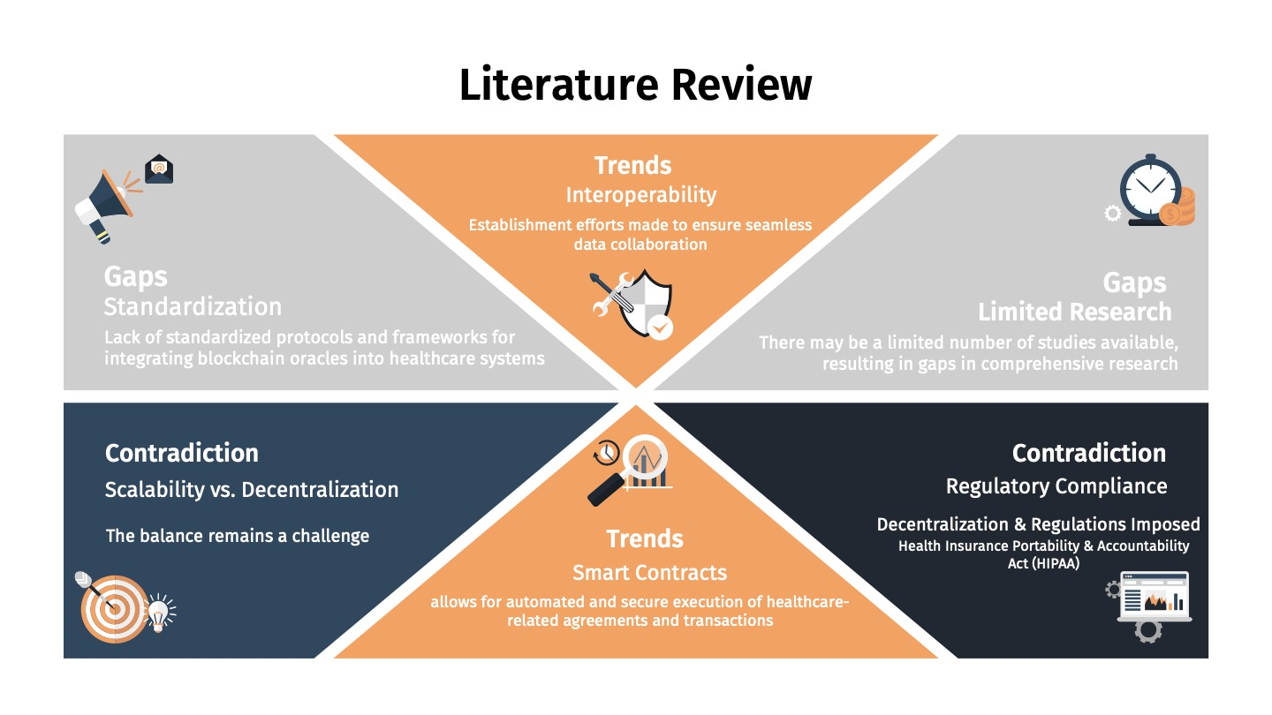

Slide 34
Feasibility Studies
Market
Economic
Scrutinization of patients demand
on full transaction confidentiality
Contribution to
job creations, income generation & tax revenues
Technical
Legal
Saturated Oracle experts
System regulations compiles with national laws
Financial
Operational
Anticipated costs & potential financial risks are well identified
Existing organizations framework boosts the system implementation

Slide 35
Analysis & Design
Peak at Blockchain Technology
Interoperability
Oracles

Slide 36
Functional Requirements
Patient & Doctor must be able to fetch patient’s health record
Insurance must be able to accept or reject claims based on patient’s allowance coverage
Fetch PHR
Respond to claims
Enter prescription
Doctor must be able to enter prescriptions
Request lab work
Redirect to another doctor
Doctor should be able to request lab works & scans
Doctor should be able to redirect patient to another doctor

Slide 37
Non-Functional Requirements
Insurance could update network
Doctor and patient to view tokens
Update network
View tokens
Update PHR
Doctor could update patient’s health record
Encryption
Privacy
Level of protection required for different types of data
Secure and protect data from unauthorized access or tampering

Slide 38
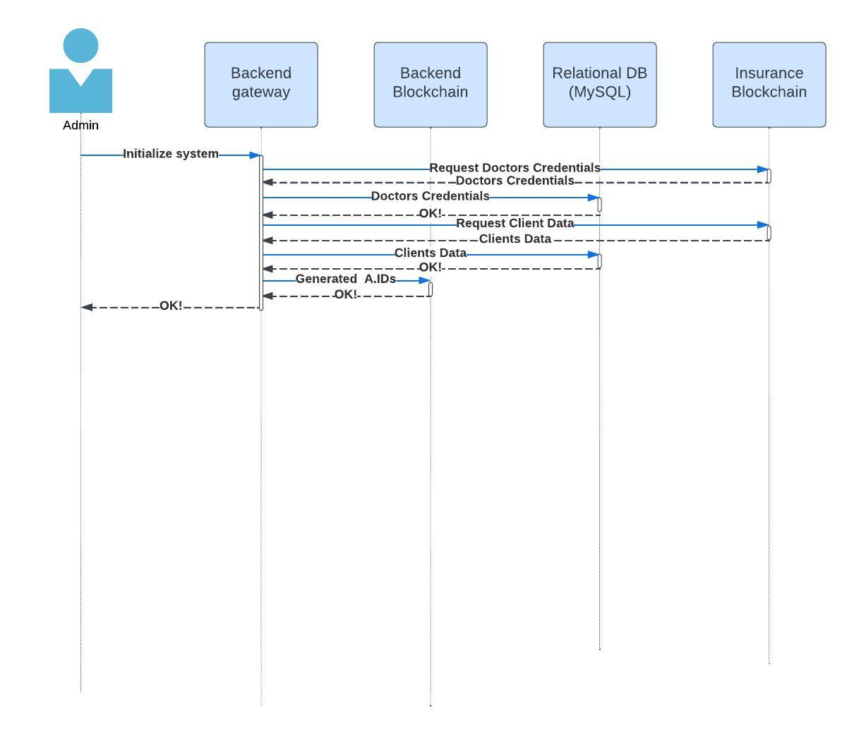
System Initialization

Slide 39
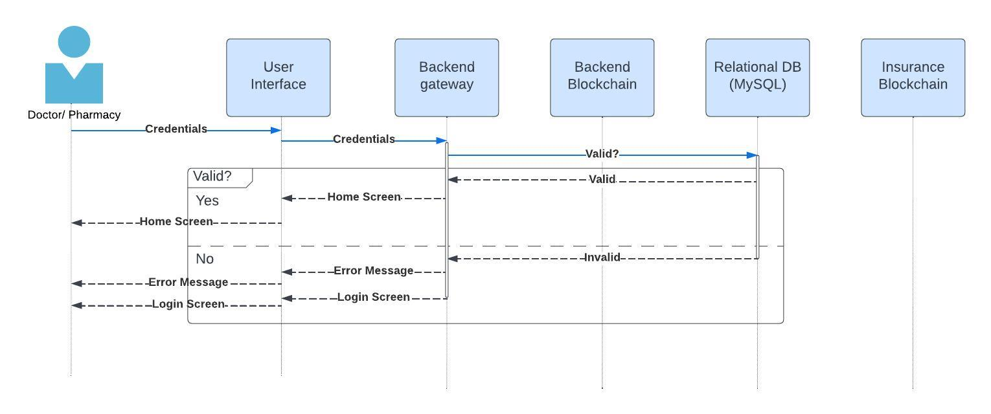
Credentials Validation

Slide 40
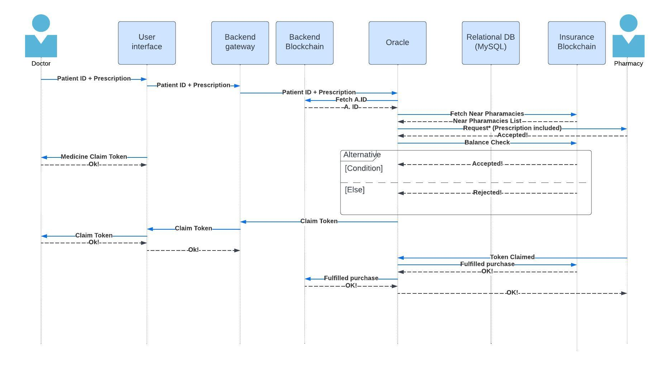
Prescription & Order

Slide 41
Proof of Concept
Specifications
Prototype

Slide 42
Technology Specifications
Backend
Frontend
Node.js
React.js
Blockchain
Relational Database
Ethereum
MySQL
Host
Encryption
Amazon Web Services
RSA

Slide 43
Conclusion
Future Project II

Slide 44
Project II
Blockchain
Relational DB
Implementation of blockchains
Creation & normalization
Oracle
Encryption
Integration with blockchains
RSA encryption implementation
Host
Frontend
AWS setup & configuration
Building UI Interface

